Slide 1
Introduction to C Programming Lab

Slide 2
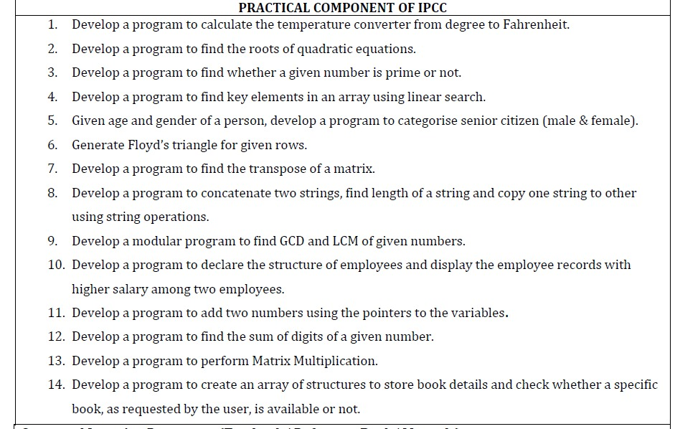

Slide 3
Develop a Program to Find the Roots of Quadratic Equations

Slide 4
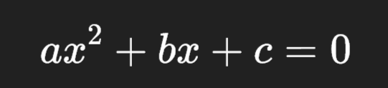
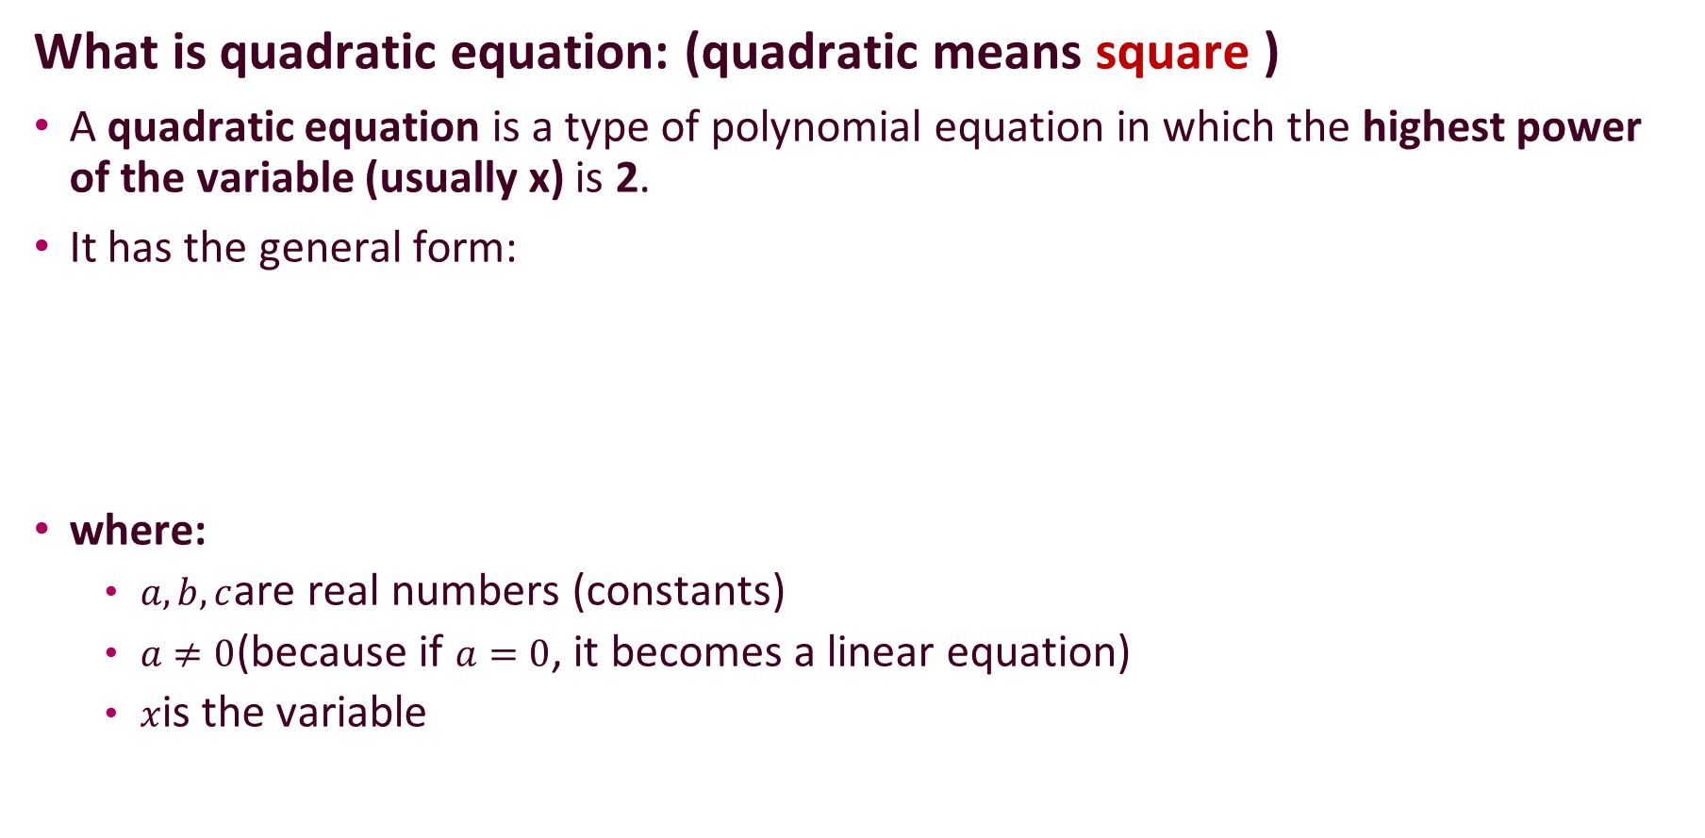
What is quadratic equation: (quadratic means square )
A quadratic equation is a type of polynomial equation in which the highest power of the variable (usually x) is 2.
It has the general form:
where:
$a,b,c$are real numbers (constants)
$a≠0$(because if $a=0$, it becomes a linear equation)
$x$is the variable

Slide 5
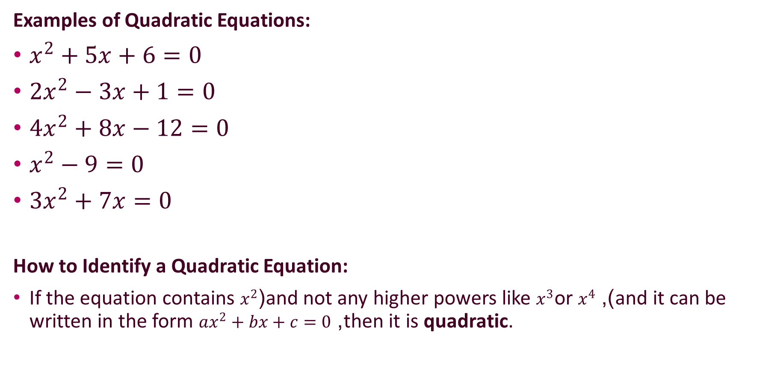
Examples of Quadratic Equations:
$x^{2}+5x+6=0$
$2x^{2}−3x+1=0$
$4x^{2}+8x−12=0$
$x^{2}−9=0$
$3x^{2}+7x=0$
How to Identify a Quadratic Equation:
If the equation contains $x^{2}$(and not any higher powers like $x^{3}$or $x^{4}$), and it can be written in the form $ax^{2}+bx+c=0$, then it is quadratic.

Slide 6
Roots of a Quadratic Equation
The roots (also called solutions or zeros) of a quadratic equation are the values of x that make the equation true — that is, the values that satisfy
In other words, if you plug a root value into the equation, the result becomes 0.

Slide 7
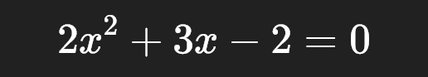
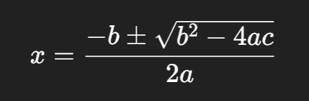
Example Equation:
Use the quadratic formula:

Slide 8
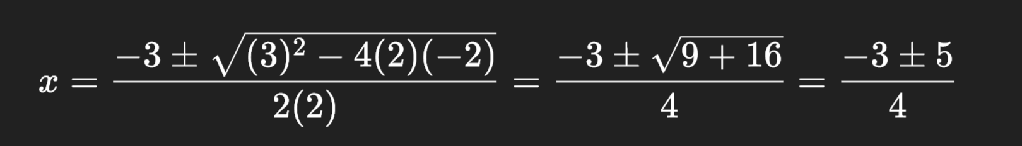
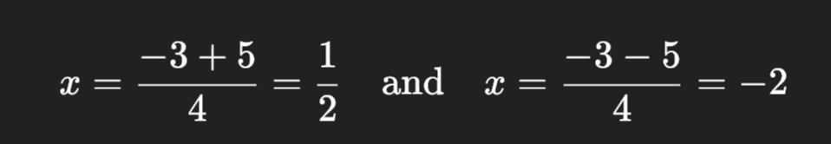

Here, $a=2,b=3,c=−2$
So,
Roots are ½ and -2.

Slide 9
Why the word “roots”?
The word “root” in mathematics comes from the idea of a foundation — just like the roots of a tree are the base or starting point of its growth.
In equations, a root is the value of x that makes the equation become zero — the point where the expression “starts” or “balances”.

Slide 10


Approach:
When a quadratic equation is like:
We calculate the discriminant:

Slide 11
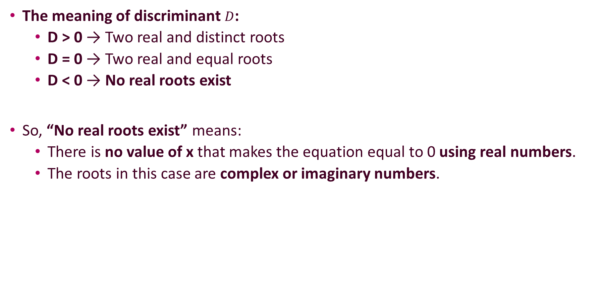
The meaning of discriminant $D$:
D > 0 → Two real and distinct roots
D = 0 → Two real and equal roots
D < 0 → No real roots exist
So, “No real roots exist” means:
There is no value of x that makes the equation equal to 0 using real numbers.
The roots in this case are complex or imaginary numbers.

Slide 12
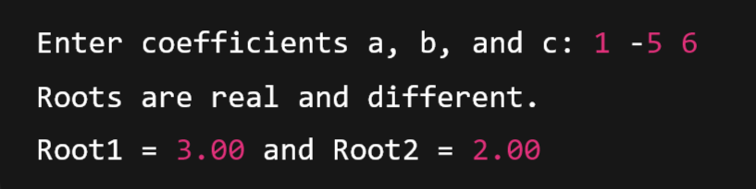
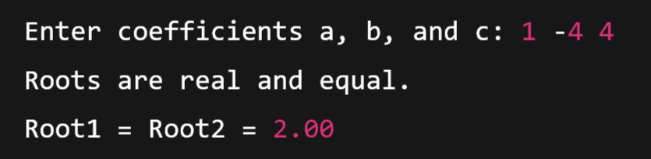
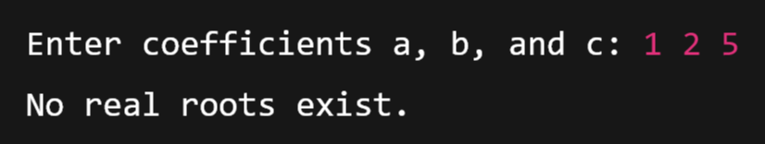
Test Case-1:
Test Case-2:
Test Case-3:

Slide 13
Program-3: Develop a Program to Find whether a given number is Prime or Not

Slide 14
What is a Prime Number?
A prime number is a natural number greater than 1 that has only two factors:
1 and
the number itself
👉 In simple words:
A prime number can be divided evenly only by 1 and itself — no other number should divide it.
When we say “a number divides another number evenly”, it means the remainder is 0 after division.

Slide 15
Examples of Prime Numbers:
Number | Divisible By | Prime or Not
2 | 1, 2 | Prime
3 | 1, 3 | Prime
4 | 1, 2, 4 | Not Prime (divisible by 2)
5 | 1, 5 | Prime
6 | 1, 2, 3, 6 | Not Prime (divisible by 2 and 3)
7 | 1, 7 | Prime

Slide 16
Approach
Let’s say the user enters a number — for example, num = 7.
Step-by-step logic:
If num <= 1 → it’s not prime. (Because 0 and 1 are not prime by definition.)
Start dividing num by all numbers from 2 up to num - 1.
If any number divides num completely (num % i == 0), it means it has a factor other than 1 and itself → not prime.
If none divide it, then it’s prime.

Slide 17
Example Walkthrough:
For num = 7 Check divisibility:
7 % 2 = 1 → not divisible
7 % 3 = 1 → not divisible
7 % 4 = 3 → not divisible
7 % 5 = 2 → not divisible
7 % 6 = 1 → not divisible
Since no number divides it evenly, 7 is a prime number

Slide 18
Program-4: Develop a Program to find key elements in an array using Linear Search

Slide 19

What is Linear Search?
Linear Search is the simplest way to find something in a list or an array.
Imagine you have a list of numbers written on paper:
Now someone asks you: “Is the number 30 in the list?”
How would you check? You start from the first number and check one by one:
Is 10 equal to 30? ❌ No
Is 25 equal to 30? ❌ No
Is 30 equal to 30? ✅ Yes! Found it!
That’s exactly how Linear Search works.

Slide 20
In simple terms:
You start from the beginning of the array.
Compare each element with the value you are looking for (called the key).
If you find it → stop and say “found”.
If you reach the end and don’t find it → say “not found”.
Why is it called Linear?
Because you go in a straight line, checking one item after another — no skipping or jumping.

